Slide 1
Multiple Graphs

Slide 2
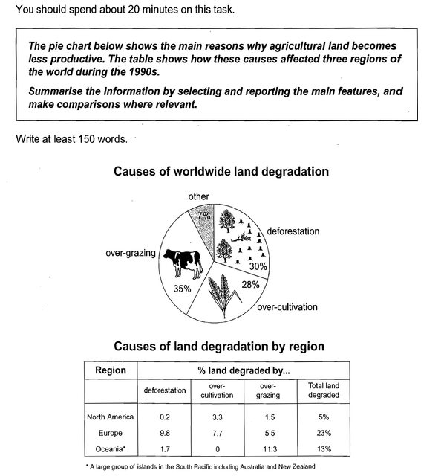

Slide 3
SAMPLE ANSWER
The pie chart illustrates the primary causes of land deterioration across the globe while the table outlines how three different regions were affected by these damaging factors in the 1990s. It is clear from the pie chart that the main reason why farmland becomes less productive is overgrazing. The data in the table reveals that Europe had the highest percentage of degraded land compared to North America and Oceania for the period recorded.
The pie chart presents two additional key reasons for the decrease in the productivity of agricultural land. These are deforestation and over-cultivation. Although tree clearance is almost as damaging as grazing too many animals, at 30%, it has a 5% lower impact than overgrazing. Excessive cultivation is the least problematic at just over a quarter of the total.
According to the table, 23% of Europe’s agricultural land was affected by these damaging practices. This was almost double the percentage in Oceania, the next most affected region. North America experienced by far the lowest level of productivity loss with a figure of just 5% of its total agricultural land.
(184 words)

Slide 4
BREAKDOWN AND EXPLANATION

Slide 5
Write an Introduction
Question:
The pie chart shows the main reasons why agricultural land becomes less productive. The table shows how these causes affected three regions of the world during the 1990s.
Introduction (Paragraph 1):
The pie chart illustrates the primary causes of land deterioration across the globe while the table outlines how three different regions were affected by these damaging factors in the 1990s.
DO NOT GIVE ANY HEADING
THE HEADINGS OF THE PARAGRAPHS ARE FOR EXPLANATION ONLY
YOUR WRITING SHOULD ONLY HAVE PARAGRAPHS AS SHOWN IN THE LAST SLIDE

Slide 6
Write an Overview
*Overgrazing: a situation in which there are too many cows or other animals eating grass in an area, which damages the environment.
Pie chart: The biggest cause of land degradation worldwide is overgrazing.
Table: Europe had the highest percentage of degraded land.
Overview (Paragraph 1):
It is clear from the pie chart that the main reason why farmland becomes less productive is overgrazing. The data in the table reveals that Europe had the highest percentage of degraded land compared to North America and Oceania for the period recorded.
DO NOT GIVE ANY HEADING
THE HEADINGS OF THE PARAGRAPHS ARE FOR EXPLANATION ONLY
YOUR WRITING SHOULD ONLY HAVE PARAGRAPHS AS SHOWN IN THE LAST SLIDE

Slide 7
Paragraph-1 (Intro+Overview)
The pie chart illustrates the primary causes of land deterioration across the globe while the table outlines how three different regions were affected by these damaging factors in the 1990s. It is clear from the pie chart that the main reason why farmland becomes less productive is overgrazing. The data in the table reveals that Europe had the highest percentage of degraded land compared to North America and Oceania for the period recorded.
DO NOT GIVE ANY HEADING
THE HEADINGS OF THE PARAGRAPHS ARE FOR EXPLANATION ONLY
YOUR WRITING SHOULD ONLY HAVE PARAGRAPHS AS SHOWN IN THE LAST SLIDE

Slide 8
Write the 1st Detail Paragraph
Pie chart: The biggest cause of land degradation worldwide is overgrazing.
Paragraph 2:
The pie chart presents two additional key reasons for the decrease in the productivity of agricultural land. These are deforestation and over-cultivation. Although tree clearance is almost as damaging as grazing too many animals, at 30%, it has a 5% lower impact than overgrazing. Excessive cultivation is the least problematic at just over a quarter of the total.
DO NOT GIVE ANY HEADING
THE HEADINGS OF THE PARAGRAPHS ARE FOR EXPLANATION ONLY
YOUR WRITING SHOULD ONLY HAVE PARAGRAPHS AS SHOWN IN THE LAST SLIDE

Slide 9
Write the 2nd Detail Paragraph
Table: Europe had the highest percentage of degraded land.
Paragraph 3:
According to the table, 23% of Europe’s agricultural land was affected by these damaging practices. This was almost double the percentage in Oceania, the next most affected region. North America experienced by far the lowest level of productivity loss with a figure of just 5% of its total agricultural land.
DO NOT GIVE ANY HEADING
THE HEADINGS OF THE PARAGRAPHS ARE FOR EXPLANATION ONLY
YOUR WRITING SHOULD ONLY HAVE PARAGRAPHS AS SHOWN IN THE LAST SLIDE

Slide 10
SAMPLE ANSWER
The pie chart illustrates the primary causes of land deterioration across the globe while the table outlines how three different regions were affected by these damaging factors in the 1990s. It is clear from the pie chart that the main reason why farmland becomes less productive is overgrazing. The data in the table reveals that Europe had the highest percentage of degraded land compared to North America and Oceania for the period recorded.
The pie chart presents two additional key reasons for the decrease in the productivity of agricultural land. These are deforestation and over-cultivation. Although tree clearance is almost as damaging as grazing too many animals, at 30%, it has a 5% lower impact than overgrazing. Excessive cultivation is the least problematic at just over a quarter of the total.
According to the table, 23% of Europe’s agricultural land was affected by these damaging practices. This was almost double the percentage in Oceania, the next most affected region. North America experienced by far the lowest level of productivity loss with a figure of just 5% of its total agricultural land.
(184 words)

